Slide 1
The Great Sending
What is it?
How do we get involved?

Slide 2
The Great Sending
The Great Sending is God’s eternal plan for restoring His entire creation to Himself.
(Ephesians 1:10; 2 Corinthians 5:16-21)

Slide 3
The Great Sender
Our God is first and foremost a missionary God.
From the moment of the Fall, God became the Great Missionary.
God’s Word from Genesis to Revelation is a Missionary’s story.
God would have us read His Word through His Missionary eyes.

Slide 4
Reading God’s Word through
His Missionary Eyes
Then he said to them, “These are my words that I spoke to you while I was still with you, that everything written about me in the Law of Moses and the Prophets and the Psalms must be fulfilled.” Then he opened their minds to understand the Scriptures, and said to them, “Thus it is written, that the Christ should suffer and on the third day rise from the dead, and that repentance to the forgiveness of sins should be proclaimed in his name to all nations, beginning from Jerusalem. You are witnesses of these things (Luke 24)

Slide 5
Reading God’s Word through
His Missionary Eyes
Christopher Wright in The Mission of God:
“Luke tells us that . . . ‘Jesus opened their minds so they could understand the Scriptures,’ or, as we might put it, he was setting their hermeneutical orientation and agenda. The proper way for disciples of the crucified and risen Jesus to read their Scriptures is messianically and missionally.”

Slide 6
Reading God’s Word through
His Missionary Eyes
Jesus’ mission to save the world (John 3:16-17) is the sum and substance of His Messianic anointing.
Embracing the Lord Jesus as Messiah also means embracing His universal mission to reconcile the world to His Father.

Slide 7
Messiah = Missionary
As God’s Missionary, Jesus stands as the corner stone upon which He builds His Church.
“Who do people say that the Son of Man is?”
Jesus posed this question in the district of Caesarea Philippi. the vortex of human darkness, both Jew and Gentile.
Notes:
As God’s missionary, Jesus is the very stone upon which He builds His Church.
Jesus declared His intention to “Build His Church” while with His disciples in the region of Caesarea Philippi
Caesarea Philippi is an especially dark pagan place being the religious center for the worship of Pan which included bestial practices.
Nearby stood the ancient altar that Jeroboam erected at Dan, which led God’s people into idolatry.
Taken together, Caesarea Philippi becomes the vortex for universal spiritual darkness (both Jew and Gentile).
It is in this vortex that Jesus declares His “missional offensive” and the gates of hell will not prevail against it.

Slide 8
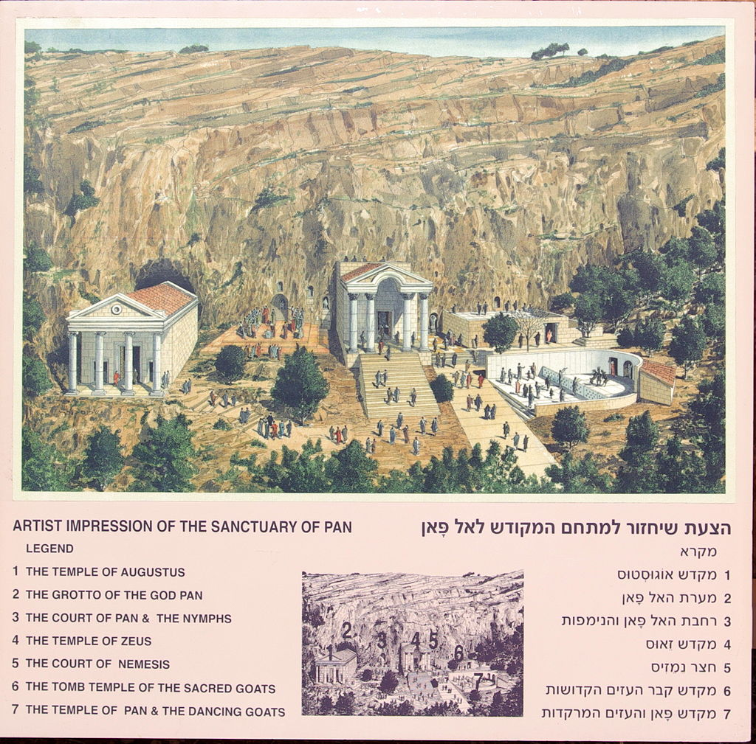
You are the Christ

Slide 9
Messiah = Missionary
The stone of stumbling for God’s people
Jesus’ kinsmen at Nazareth (Luke 4)
My house shall be called a house of prayer for the nations. (Matthew 21)
The stone that the builders rejected has become the cornerstone. (Matthew 21)

Slide 10
The Great Sending
God’s Mission is the Holy Spirit’s road map
Guiding our understanding of His Word.
Guiding our footsteps into His world.

Slide 11
The Great Sending
Three basic points:
Our heavenly Father has a missionary heart; He sent His Son to restore His broken creation to Himself.
Our heavenly Father delights in having us join His Son in His missionary service to the world.
The Lord will accomplish His Mission
Notes:
Using the Missio Dei as the Spirit’s roadmap into the Word,
Boil these five down to three basic points:
Our heavenly Father has a missionary heart; He sent His Son to restore His broken creation to Himself.
Our heavenly Father delights in having us join His Son in His missionary service to the world.
The Lord will accomplish His Mission

Slide 12
God’s Mission to the World
The Nations
The Nations
Israel
Israel

Slide 13
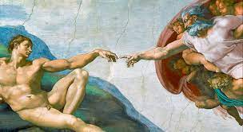
God’s “Yes”: Adam & Eve

Slide 14
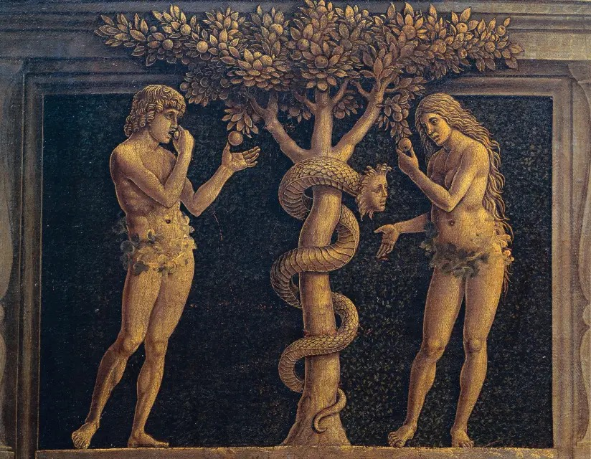
Man’s “NO”

Slide 15
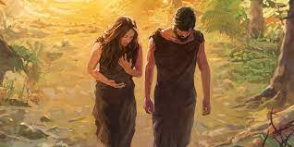
God’s “Yes”

Slide 16
The Great Sender
Key to God’s missionary plan is His decision to call sinful, broken people to participate fully with Him in His great work.

Slide 17
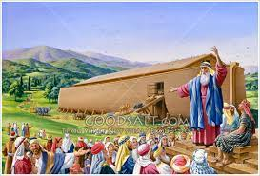
Noah and Family

Slide 18
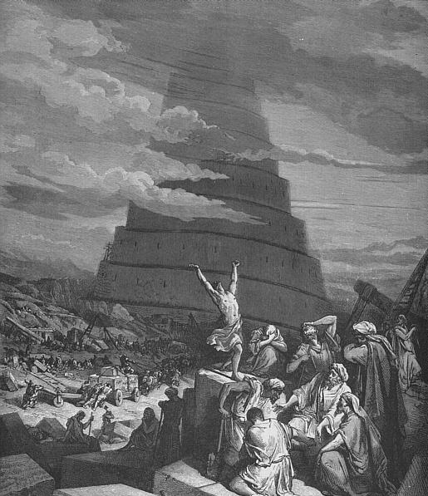
Man’s “NO”

Slide 19
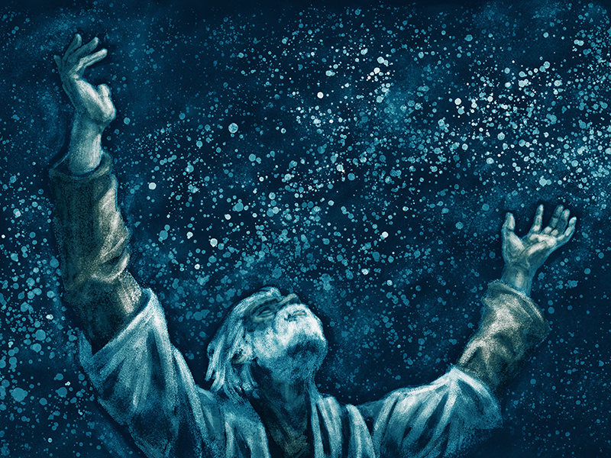
God’s “Yes”: Abraham

Slide 20
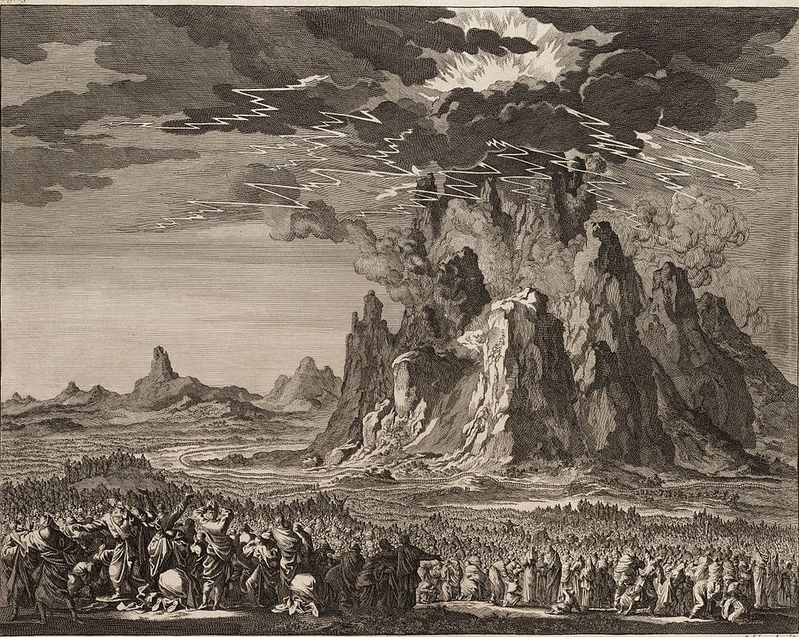
Israel and Mt. Sinai

Slide 21
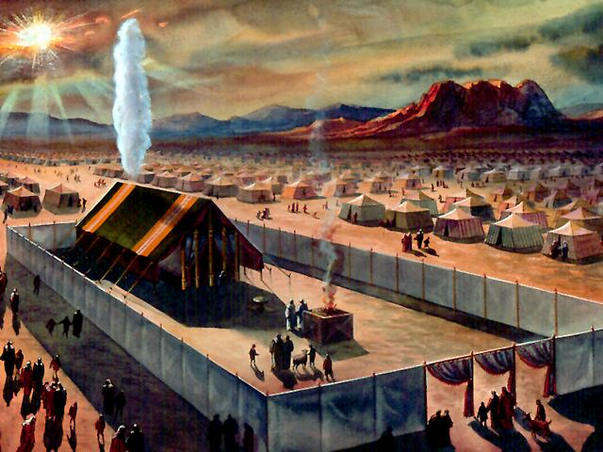
A Sent People

Slide 22
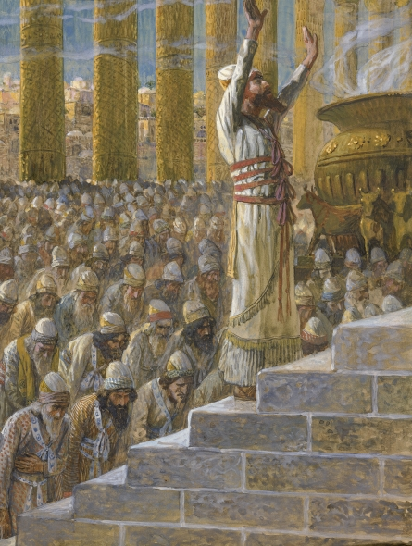
A Temple for the Nations

Slide 23
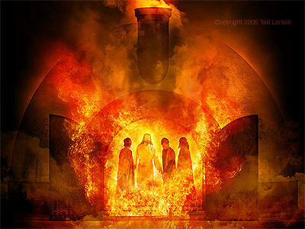
God’s “Yes”: Babylon

Slide 24
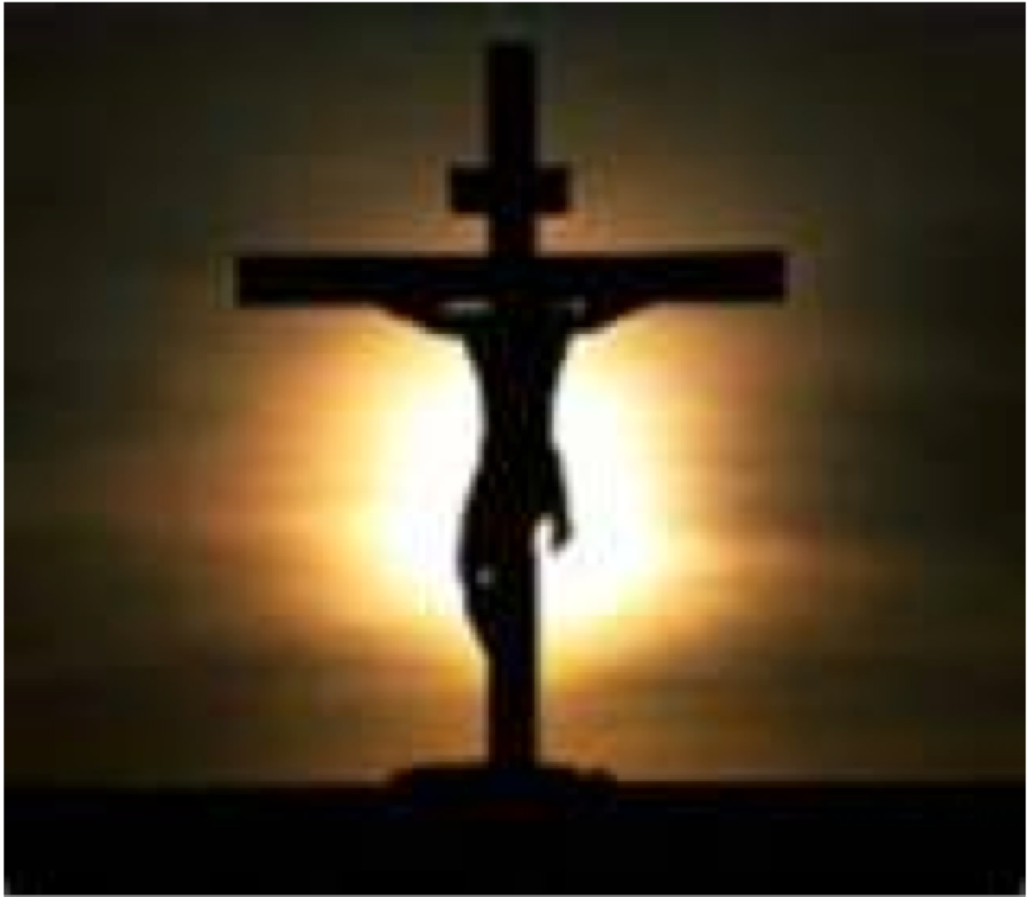
God’s “Yes”: His Son

Slide 25
The Great Sent One
The Great Sending begins and ends
with our Lord Jesus Christ.

Slide 26
The Great Sent One
Jesus’ three missionary actions
Jesus must suffer
Jesus must rise from the dead
Jesus must proclaim the Gospel to the nations

Slide 27
The Great Sent One
Jesus still serves as His Father’s Missionary
Peter stated at Pentecost:
“The Lord said to my Lord, ‘Sit at my right hand, until I make your enemies your footstool’” (Acts 2)
Being therefore exalted at the right hand of God, and having received from the Father the promise of the Holy Spirit, he has poured out this that you yourselves are seeing and hearing. (Acts 2)

Slide 28
The Great Sender
As Lord of all, Jesus continues The Great Sending throughout the world
Being “exalted at the right hand of God,” Jesus poured out His missionary Spirit on His Church.
But you will receive power when the Holy Spirit has come upon you, and you will be my witnesses . . . to the end of the earth.”

Slide 29
The Great Sender
Jesus still serves as His Father’s Missionary
Peter continued:
Repent and be baptized every one of you in the name of Jesus for the forgiveness of your sins, and you will receive the gift of the Holy Spirit. For the promise is for you and for your children and for all who are far off, every one whom the Lord our God calls to himself. (Acts 2)

Slide 30
Reading God’s World Through His Missionary Eyes

Slide 31
Reading God’s World through
His Missionary Eyes
Pre-Christendom
AD 30-313
Christendom
AD 313-2022
Lutheran
1517-2022

Slide 32
Church in Charge
Confident!
Notes:
On our way!
We planned a family trip.
Itinerary set, correct highway maps in the glove box, bags packed in the trunk, snacks packed up front.
Set our GPS with the correct coordinates of our destination.
We pull out of the driveway enjoying a high degree of confidence and expectation.
Going down the Highway
All is going well
On schedule

Slide 33
Church in Charge

Slide 34
Church in Charge

Slide 35
Meeting Jesus

Slide 36
Word &
Sacrament

Slide 37
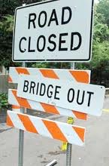
Oops
Not in Charge
Notes:
Suddenly, we see a barricade on the freeway with the sign “Bridge Out”
A great storm surge washed out the bridge the night before
No detour signs have been posted, but there are some side roads available
We turn off the main highway and begin to make our way down an unknown road
Feeling insecure, never gone this way before.
Anxiety creeps into the car.
How do we know that this road goes anywhere?
We should turn back.
We should wait on the highway; they will have the bridged repaired soon.

Slide 38
Church not in Charge

Slide 39
The Collapse of Christendom
Christendom
313-2013

Slide 40
When the Bridge
is Out
Recalculating!
Notes:
GPS: Recalculating
A sense of relief sweeps over us.
While we do not know the way, we are confident that the GPS does and will guide us safely to our destination.
We are in unfamiliar territory
We cannot see down the road very far
Our GPS with its satellite vantage point sees so much more
Keep this picture in mind as discuss “Following Jesus in Uncertain Terrain”

Slide 41
Recalculating
Repent, the Kingdom of God is at hand. Matthew 4
Notes:
Jesus began His Missionary Ministry with the words, “Repent, the Kingdom of God is at hand.” Matthew 4. I would offer three thoughts that may help guide our journey

Slide 42
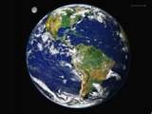
Reading God’s World through
His Missionary Eyes
Post-
Churched
Pre-
Churched
Christendom

Slide 43
Christendom
Mission Field

Slide 44
Post-Christendom Observations
While our ministry contexts have radically shifted toward a missionary (pre-churched) reality our methods of proclaiming the Gospel in Word and Sacrament have remained thoroughly entrenched in the reality of Christendom.
Notes:
Post-Churched: The community around the church is increasingly unchurched, more and more reflecting the “pre-churched” context of ministry. At the same time, the church continues to operate with the assumptions of a “churched” society or context.

Slide 45
Christendom

Slide 46
Mission Field

Slide 47
Mission Field

Slide 48
Christendom

Slide 49
Mission Field

Slide 50
Mission Field

Slide 51
Christendom

Slide 52
Mission Field

Slide 53
Christendom
Unchurched
Unchurched
W/S
Altar/Pulpit
Unchurched
Unchurched
Auxiliary
Laity
Unchurched

Slide 54
Christendom
Proclaiming the Gospel where the church is in charge
Divine Service
Pastor Centered

Slide 55
Mission Field
Unchurched
Unchurched
W/S
Altar/Pulpit
Unchurched
Unchurched
Auxiliary
Laity
Unchurched

Slide 56
Great Sending Defined
Proclaiming the Gospel where the Church is not in charge.
Our everyday world
Primarily a Lay movement

Slide 57
Recovering the Missionary Priesthood
But you are a chosen race, a royal priesthood, a holy nation, a people for his own possession, that you may proclaim the excellencies of him who called you out of darkness into his marvelous light.
Notes:
For the world
Peter, an apostle of Jesus Christ, To those who are elect exiles of the dispersion . . . according to the foreknowledge of God the Father, in the sanctification of the Spirit, for obedience to Jesus Christ and for sprinkling with blood

Slide 58
Reading your Place in God’s world through His Missionary Eyes

Slide 59
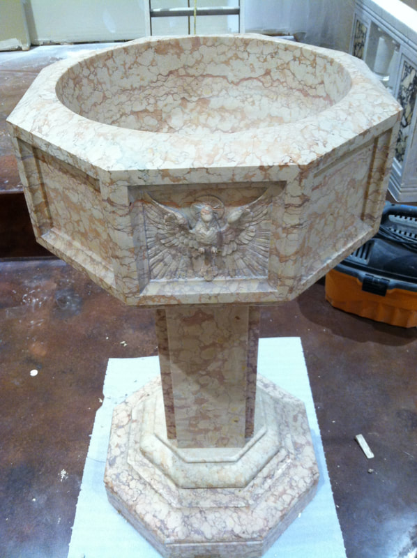
Baptized into Jesus

Slide 60
Baptized into His Mission

Slide 61
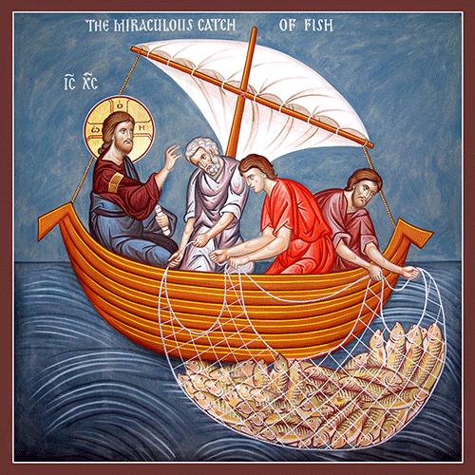
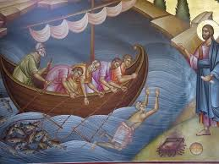
Two Fish Stories

Slide 62
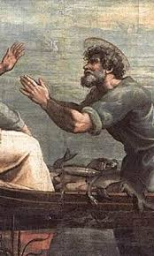
Luke 5 (The Beginning)

Slide 63
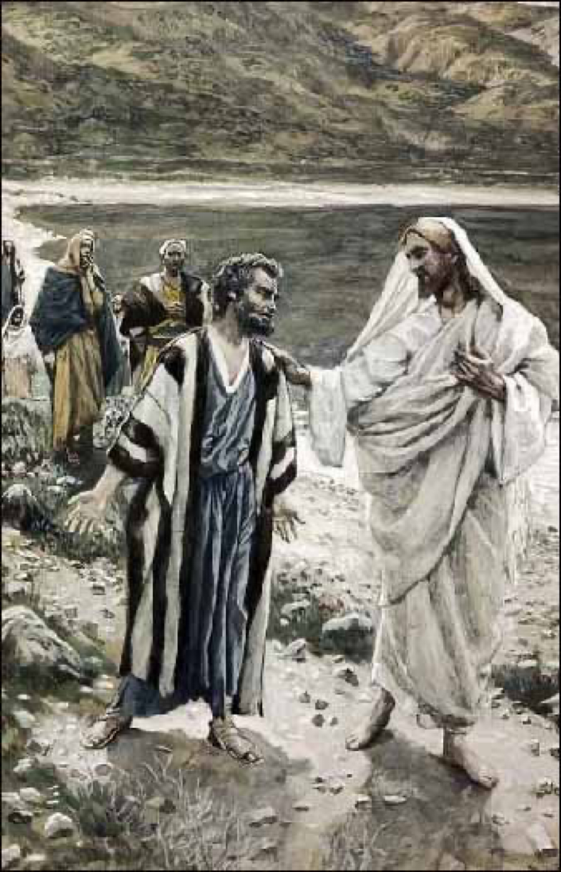
John 21 (The End)

Slide 64
The Great Sending
Centers in knowing our Father’s heart and embracing it as our own.

Slide 65
Knowing the heart of God
The sound of His footsteps
on the garden path

Slide 66
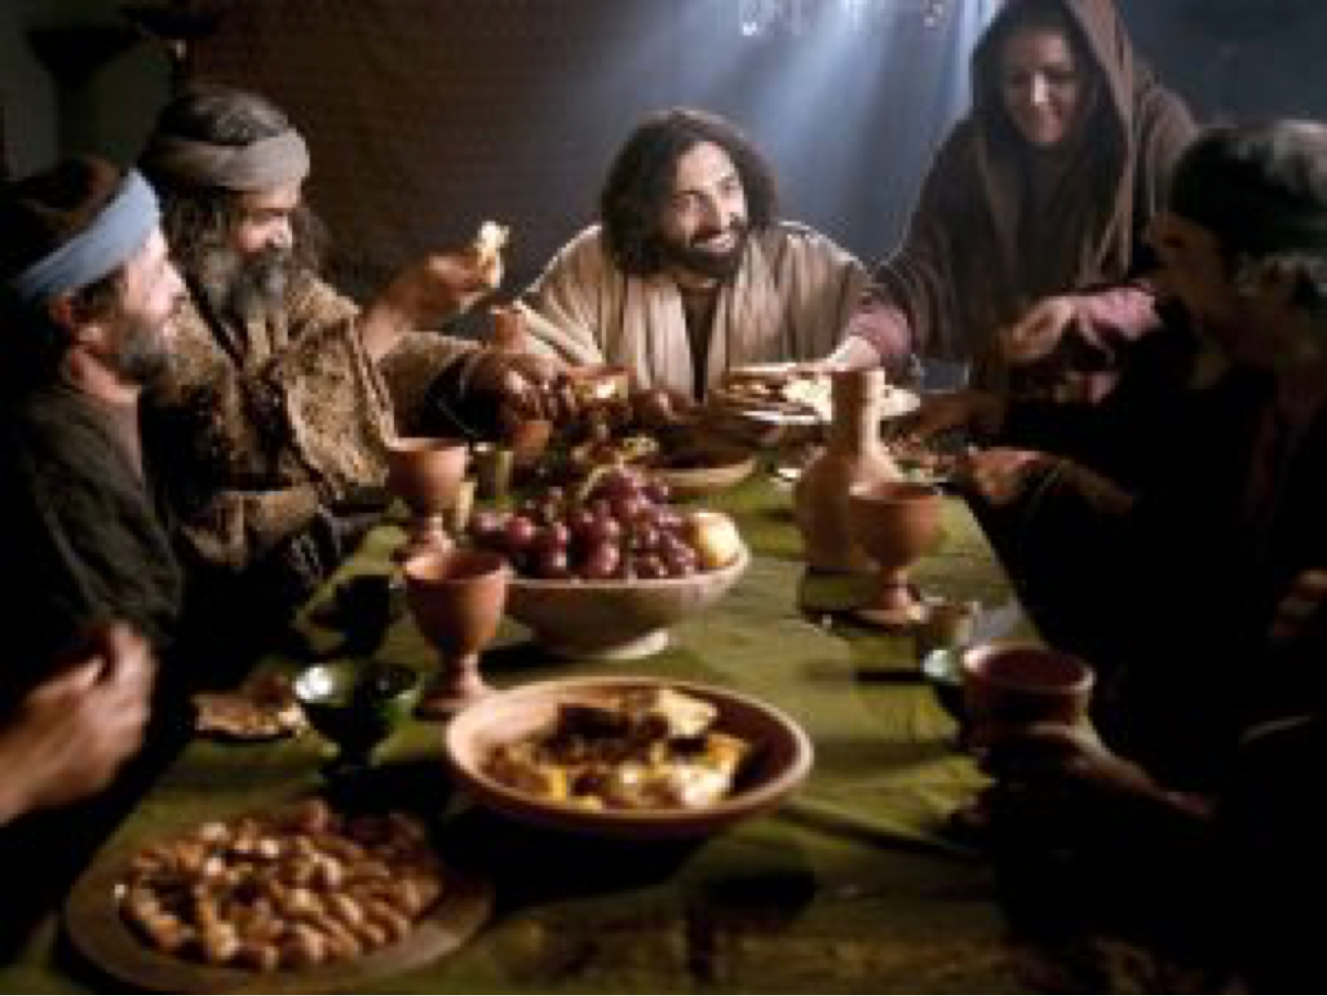
What makes God laugh?

Slide 67
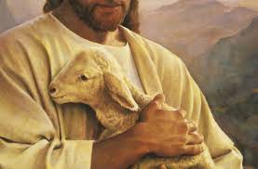
Lost Lamb

Slide 68
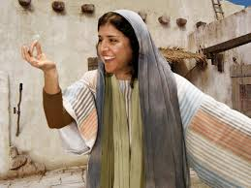
Lost Coin

Slide 69
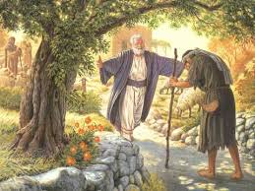
Lost Son

Slide 70
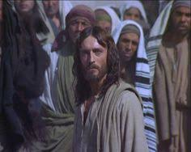
What makes God weep?

Slide 71
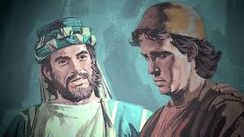
The son who didn’t leave

Slide 72
The Heart of God

Slide 73
Jesus’ Missionary Plan
“All authority in heaven and on earth has been given to me. Going therefore and make disciples of all nations, baptizing them in the name of the Father and of the Son and of the Holy Spirit, teaching them to observe all that I have commanded you. And behold, I am with you always, to the end of the age.” (Matthew 28)

Slide 74
Jesus’ Missionary Plan
“All authority in heaven and on earth has been given to me. Going therefore and make disciples of all nations, baptizing them in the name of the Father and of the Son and of the Holy Spirit, teaching them to observe all that I have commanded you. And behold, I am with you always, to the end of the age.” (Matthew 28)

Slide 75
As you GO into your
Everyday World

Slide 76
Church’s Missionary Plan
Lord will you at this time restore the Kingdom to Israel?

Slide 77
Jesus’ Missionary Plan
Lord will you at this time restore the Kingdom to Israel?
You will be my witnesses in Jerusalem, Judea, Samaria, ends of the earth.
She who is at Babylon, who is likewise chosen, sends you greetings . . .

Slide 78
Jesus’ Missionary Plan
Peter, an apostle of Jesus Christ, To those who are elect exiles of the dispersion . . . according to the foreknowledge of God the Father, in the sanctification of the Spirit, for obedience to Jesus Christ and for sprinkling with blood. (1 Peter 1)
Notes:
Following Jesus in Uncertain Terrain
St. Peter fully grasped the Babylonian reality for Christ’s Church and wrote encouragingly about it: Peter, an apostle of Jesus Christ, To those who are elect exiles of the dispersion . . . according to the foreknowledge of God the Father, in the sanctification of the Spirit, for obedience to Jesus Christ and for sprinkling with blood.

Slide 79
Problem or Plan
Problem: Peter, an apostle of Jesus Christ, To God’s elect, strangers in this world, scattered throughout . . . (NIV)
Plan: Peter, an apostle of Jesus Christ, To those who are elect exiles of the dispersion . . . (ESV)
Notes:
Living as Outsiders: Problem or Plan
Problem: Peter, an apostle of Jesus Christ, To God’s elect, strangers in this world, scattered throughout . . .
Plan: Peter, an apostle of Jesus Christ, To those who are elect exiles of the dispersion
Note the “Comma”
The comma between Elect and strangers signals the reader that our “election” is a God idea.
Being strangers (outsiders) in this world is a tragic inconvenience

Slide 80
Problem or Plan
Problem: Peter, an apostle of Jesus Christ, To God’s elect, strangers in this world, scattered throughout . . . (NIV)
Plan: Peter, an apostle of Jesus Christ, To those who are elect exiles of the dispersion . . . (ESV)
Note the “comma”
Notes:
Living as Outsiders: Problem or Plan
Problem: Peter, an apostle of Jesus Christ, To God’s elect, strangers in this world, scattered throughout . . .
Plan: Peter, an apostle of Jesus Christ, To those who are elect exiles of the dispersion
Note the “Comma”
The comma between Elect and strangers signals the reader that our “election” is a God idea.
Being strangers (outsiders) in this world is a tragic inconvenience

Slide 81
As you Go
Going (following Jesus) will inevitably take us beyond (outside) our religious comfort zones.

Slide 82
As you Go
Going (following Jesus) will inevitably take us beyond (outside) our religious comfort zones.
“I am with you always”

Slide 83
The Great Promise
“Repent and be baptized every one of you in the name of Jesus Christ for the forgiveness of your sins, and you will receive the gift of the Holy Spirit. For the promise is for you and for your children and for all who are far off, everyone whom the Lord our God calls to himself.”

Slide 84
Jesus’ Missionary Plan
Learning on the go
Unconscious incompetence
Discipleship
Square
2Timothy 2:2
Unconscious competence
Conscious incompetence
Conscious competence

Slide 85
“All authority in heaven and on earth has been given to me.”
We proceed into the world as Royal Priests with the Authority of our Lord Jesus.
Priests connect the Lord with people and people with the Lord.
Pray
Partner
Proclaim

Slide 86
Jesus’ Missionary Plan
Post-Churched Non-Christians (Nones) tend to gather around relationships more than shared beliefs.
Churched Order: Believe—> Behave —>Belong
“Nones” Order: Belong—>Behave—>Believe

Slide 87
Relationships Matter
Relationships center in truly loving my neighbor
Relationships require genuine commitment
Relationships mean doing life together: Get to know and be known

Slide 88
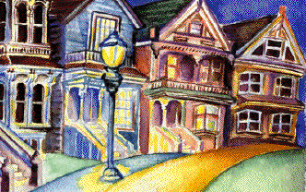
When and Where
RELATIONSHIPS in
Place #1
Place #2
Place #3

Slide 89
When and Where
RELATIONSHIPS in
Place #1
Place #2
Place #3

Slide 90
Sending Questions
Who?
Where?
When?
What’s the
starting place?
Notes:
Cultural insiders determine several factors that impact our ministry
Who speaks with credibility regarding spiritual issues
When conversations about spiritual things takes place
Where conversations about spiritual things takes place
What is the starting place for these conversations

Slide 91
Jesus’ Missionary Plan
To Whom are you a Who among the “Nones”?
Where and when do you connect?
What’s the starting place for conversation?
Answered by the “NONES” in your life

Slide 92
This presentation is shared by permission of Dr. Robert Newton. If you have any questions or comments concerning this presentation, please direct them to Dr. Newton at newton-r@sbcglobal.net or call 408-64404535

Slide 93
Our Missionary God
The sound of His footsteps
on the garden path

Slide 94
Recovering the Missionary Priesthood
Anticipate the Lord raising His Royal Priests up—men and women—once again for this very time and place.
Anticipate the Lord raising up missionaries indigenous to Post-Christendom contexts for this time and place: Young people.
How does this anticipation impact ministries in your congregation?

